Slide 1
Art styles we can go for

Slide 2
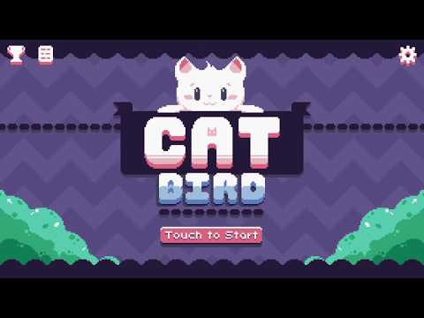
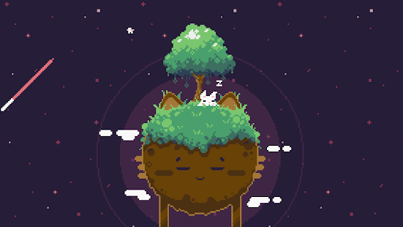
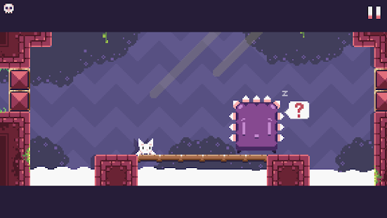
Cute Pixel art
- This game is called Cat Bird
- This is a suggested art style as it is clear and 2d, it creates an nostalgic feel to players, also it has the advantages to low resolution, rendering a smaller area uses less GPU time.
Notes:
https://www.scirra.com/forum/why-is-pixel-art-used-so-much_t74091

Slide 3
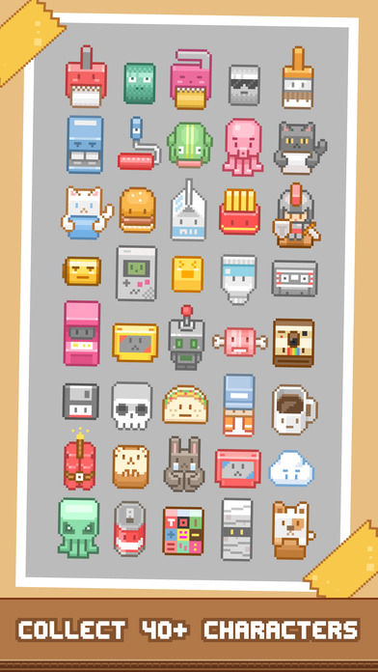
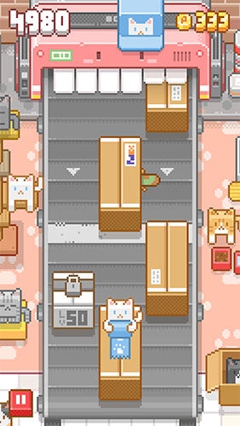

- This game is called Tape it UP!
This is another example of pixel art.

Slide 4
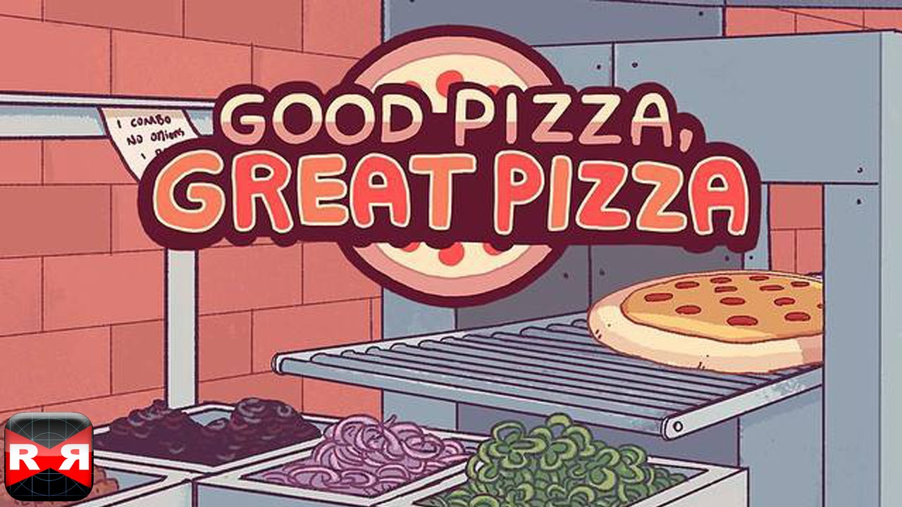
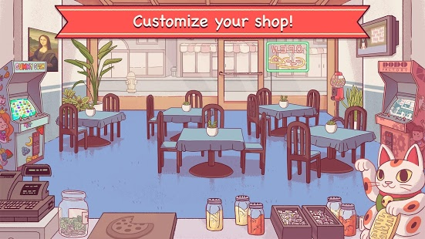
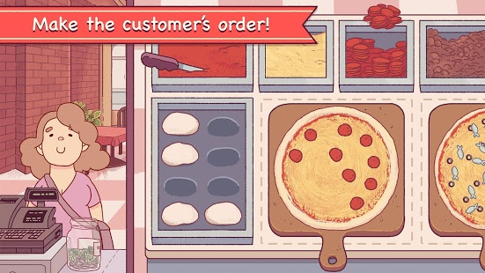
Cartoony Drawn
This game is called Good Pizza, Great Pizza
- This is suggested because its clear to the user, its 2d, it’s easy to make.

Slide 5
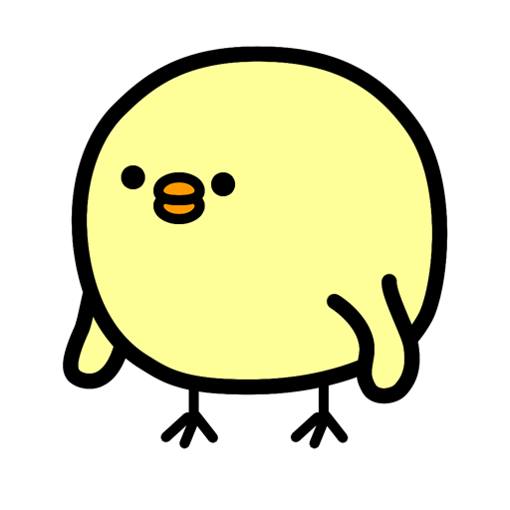
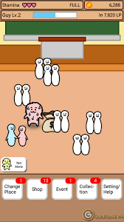

Simplistic Cartoon
This game is called Lonely Guy
This is a suggested art style as it is clear, 2d, easy to make, the most simple art style to choose.

Slide 6
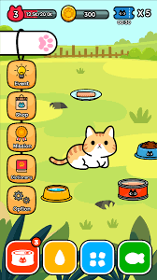
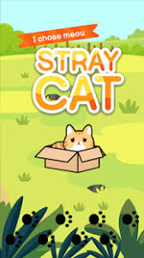
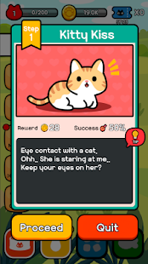
This game is called Stray Cat, another example of Simplistic Cartoon Art style

Slide 7
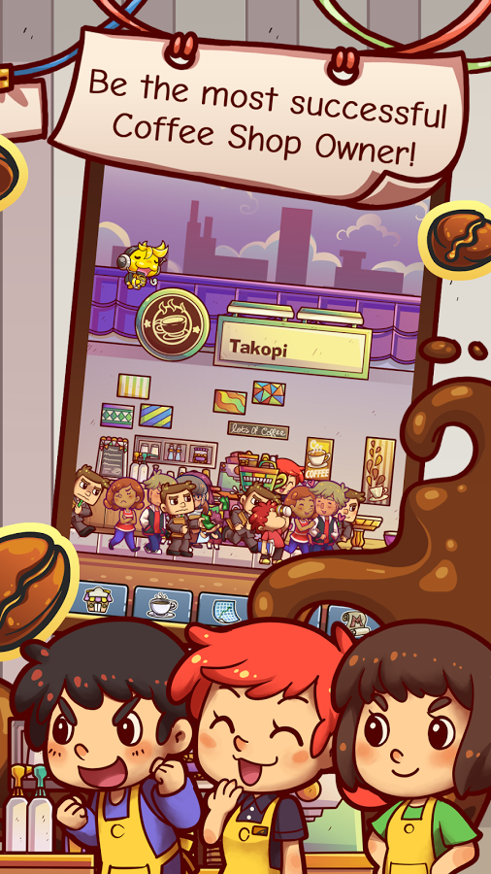
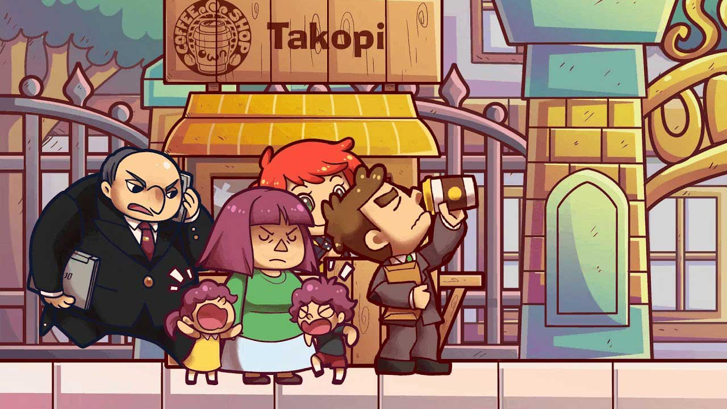
Cell Shaded cartoony art style
This game is called OwnCoffeeShop (smooth cell shaded art style)
This is a suggested art style as it makes 3d objects look more 2d, it’s not necessarily easy to make but this smooth cell shaded art has a feminine vibe to it as it is very cutsey.

